Slide 1


538’s Halloween Candy Rankings
Bryan Sam

Slide 2
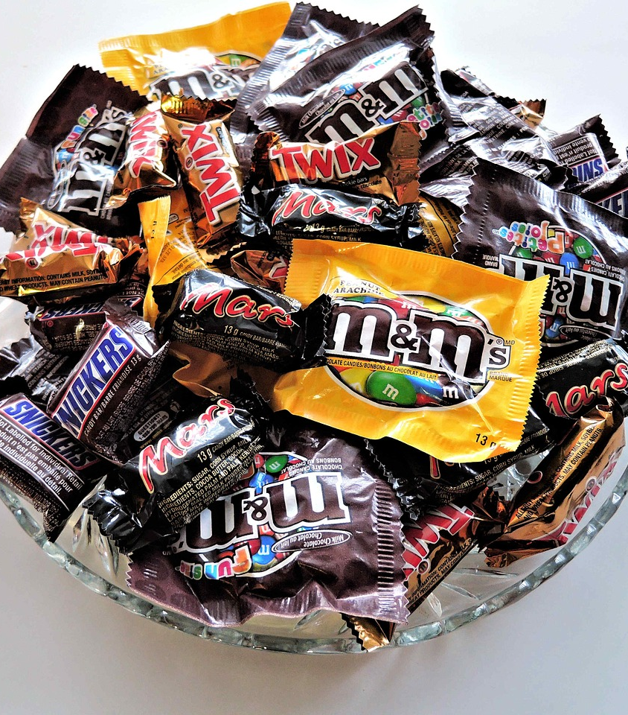
With Halloween around the corner, both kids and adults love candy especially with brains! FiveThirtyEight has a dataset of information on different types of candy. I’ll explore the dataset by asking these types of questions:
Does a candy have peanut and almond flavor?
Is there a fruity candy?
How many types of candy out there?
How much does it cost compare to other candies?
Which candy do people prefer?

Slide 3
Halloween Candy Ranking Dataset
Attribute | Description
Competitorname | Candy Manufacturer
Chocolate | Does it contain chocolate?
Fruity | Is it fruit flavored?
Caramel | Is there caramel in the candy?
Peanutyalmondy | Does it contain peanuts, peanut butter or almonds?
Nougat | Does it contain nougat?
Crispedricewafer | Does it contain crisped rice, wafers, or a cookie component?
Hard | Is it a hard candy?
Bar | Is it a candy bar?
Pluribus | Is it one of many candies in a bag or box?
Sugarpercent | The percentile of sugar it falls under within the data set.
Pricepercent | The unit price percentile compared to the rest of the set.
Winpercent | The overall win percentage according to 269,000 matchups.

Slide 4
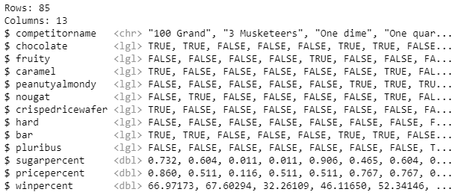
Preview of the Dataset

Slide 5
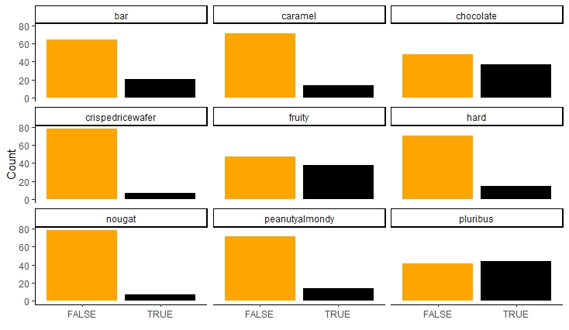
Distributions of Categorical Variables
Shows the number of TRUE’s and FALSE’s for each type of
candy in the dataset

Slide 6
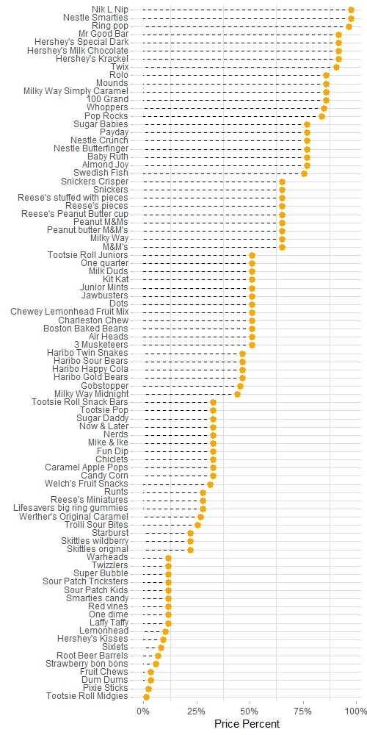
Price Percent Comparison
The pricepercent variable is the percentile rank of the candy’s price against to other candies in the dataset.
The lollipop chart shows which candy is the most and least expensive.
Most of the candies share the same ranking meaning a handful of candies are around the same price.

Slide 7
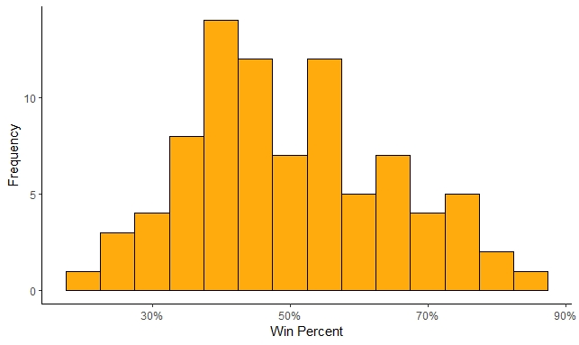
Win Percent Distribution
The winpercent variable is the percentage of people who prefer this candy over another randomly chosen candy in the dataset.
The histogram chart shows an approximate symmetrical distribution in the dataset.
Most of it seems to center between 40% to 45%.

Slide 8
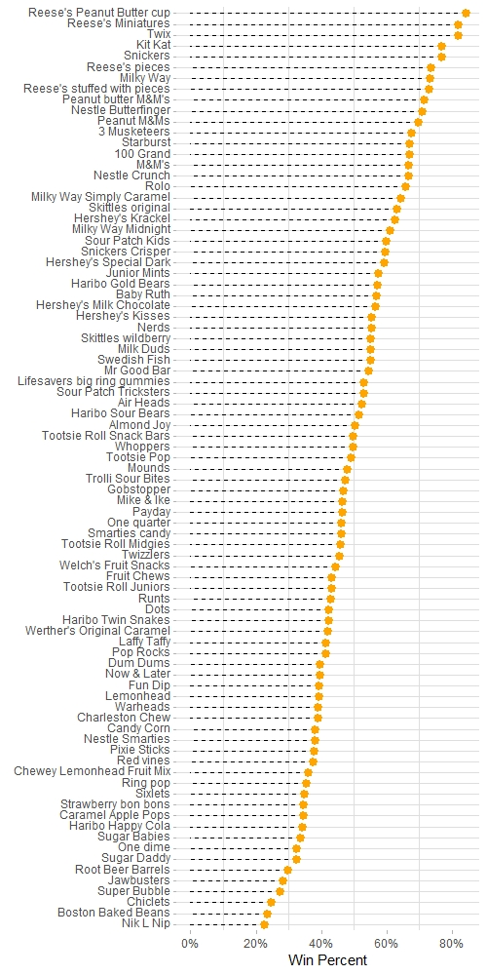
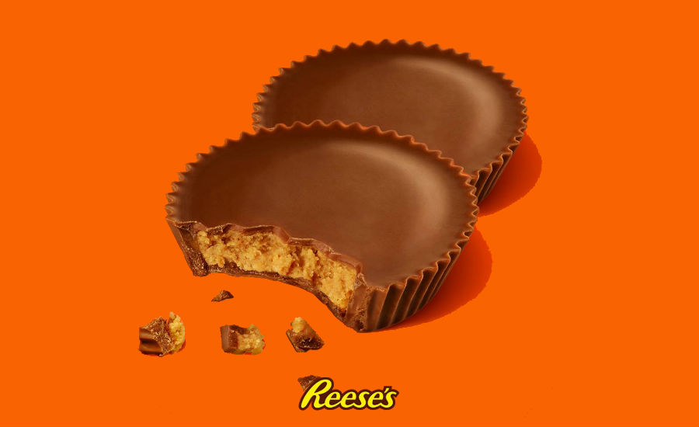
Win Percent Comparison
After looking at the histogram, another lollipop chart shows the candy rankings according to people’s preference.
Resse’s Peanut Butter Cups are people’s favorite out of all candies in the dataset.
Whereas Nik L Nip is people’s least favorite candy.

Slide 9

Thank You! Happy Halloween!

